Slide 1
Welcome to CS4222 PSLG!
With Robert and Jakub

Slide 2

Python Image manipulation
An image is very similar to a 2D List​
​
In an image every pixel is a colour made from red, green and blue or RGB for short. These are stored in our images as a 2D array​
​
Example:​
Image = ((2, 3, 2),(1, 2, 6),(4, 5, 5))​
​
In this example our first list in our list is (2, 3, 2) which in this example would make the colour dark green.

Slide 3
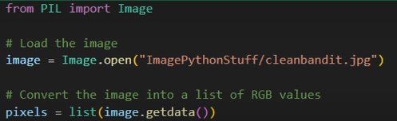
Example​

Slide 4
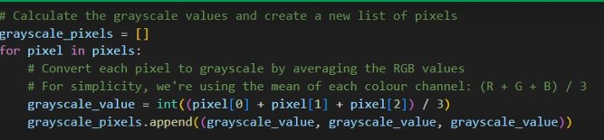
Example 2​

Slide 5
Problem 1
Using a for loop, loop through an image and add all the RGB values together and print out the total​

Slide 6
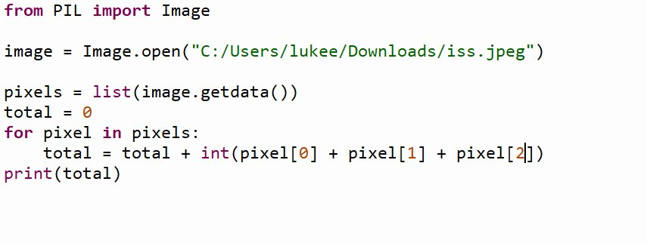
Answer:

Slide 7
Problem 2
Write a python programme that turns an image to black and white
(Hint : If we want to make an image black and white all we have to do is add the 3 RGB values together and divide by 3 and store it in a new 2D list)

Slide 8
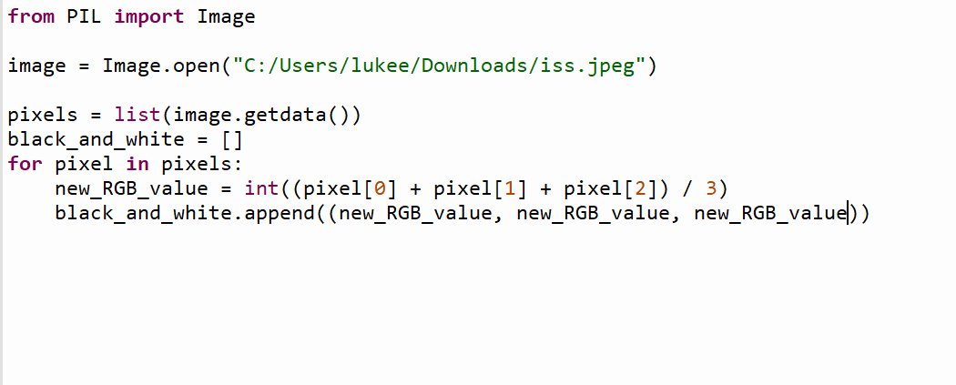
Answer:

Slide 9
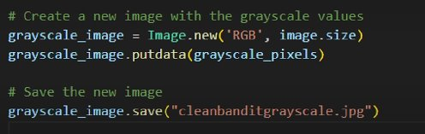
Example 3​

Slide 10
Problem 3
With your new black and white 2D list, turn it back into an image and save it as a new image

Slide 11
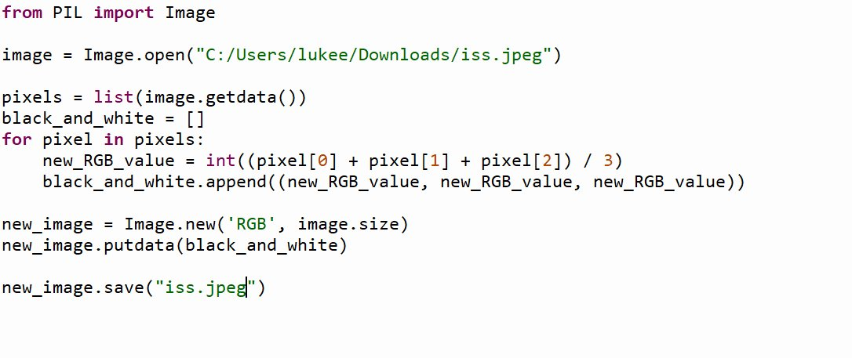
Answer:

Slide 12

Thank you for coming!

